Slide 1
Image Processing
Lecture 8
Introducing Image Processing

Slide 2
Revision
1. Introduction
1.1 What Is Digital Image Processing?
1.2 The Origins of Digital Image Processing
1.3 Examples of Fields that Use Digital Image Processing
1.3.1 Gamma-Ray Imaging
1.3.2 X-ray Imaging

Slide 3
Revision
2. Digital Image Fundamentals
2.1 Elements of Visual Perception
2.1.1 Structure of the Human Eye
2.2 Light and the Electromagnetic Spectrum
2.3 Image Sensing and Acquisition
2.3.1 Image Acquisition Using a Single Sensor
2.3.2 Image Acquisition Using Sensor Strips
2.3.3 Image Acquisition Using Sensor Arrays
2.3.4 A Simple Image Formation Model
2.4 Image Sampling and Quantization
2.4.1 Basic Concepts in Sampling and Quantization
2.4.2 Representing Digital Images
2.4.3 Spatial and Gray-Level Resolution
2.4.5 Zooming and Shrinking Digital Images

Slide 4
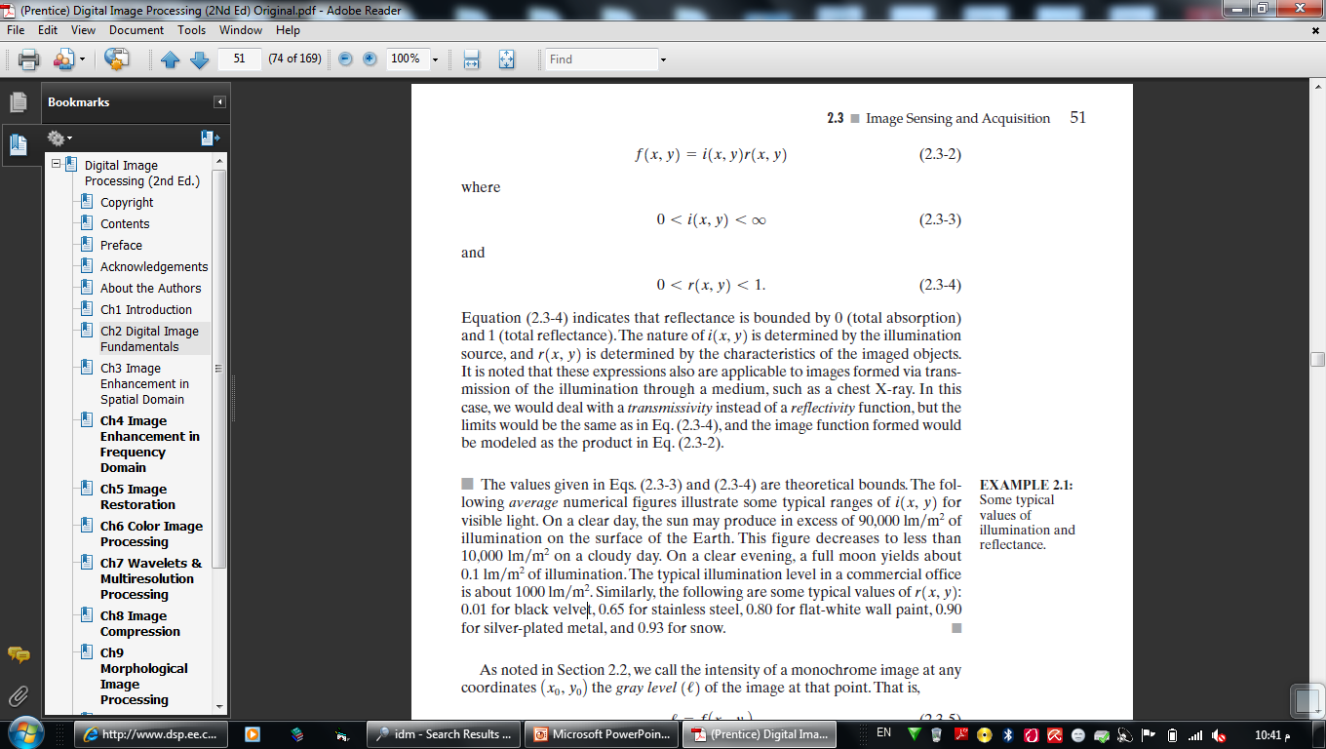
A Simple Image Formation Model
2.5 Some Basic Relationships Between Pixels
2.5.1 Neighbors of a Pixel
2.5.2 Adjacency, Connectivity, Regions, and Boundaries
2.5.3 Distance Measures
2.5.4 Image Operations on a Pixel Basis

Slide 5
Revision
3. Image Enhancement in the Spatial Domain
3.2 Some Basic Gray Level Transformations
3.2.1 Image Negatives
3.2.2 Log Transformations
3.2.3 Power-Law Transformations
3.2.4 Piecewise-Linear Transformation Functions
3.3 Histogram Processing
3.3.1 Histogram Equalization
3.3.3 Local Enhancement 103
3.4 Enhancement Using Arithmetic/Logic Operations
3.4.1 Image Subtraction
3.4.2 Image Averaging

Slide 6
Revision
3.5 Basics of Spatial Filtering
3.6 Smoothing Spatial Filters
3.6.1 Smoothing Linear Filters
3.6.2 Order-Statistics Filters
3.7 Sharpening Spatial Filters
3.7.1 Foundation
3.7.2 Use of Second Derivatives for Enhancement–
The Laplacian
3.7.3 Use of First Derivatives for Enhancement-
The Gradient

Slide 7
Revision
4. Image Enhancement in the Frequency Domain
4.2 Fourier Transform
4.2.1 The One-Dimensional Fourier Transform and its
Inverse
4.2.2 The Two-Dimensional DFT and Its Inverse 154
4.2.3 Filtering in the Frequency Domain 156
4.2.4 Correspondence between Filtering in the Spatial
and Frequency Domains
4.3 Smoothing Frequency-Domain Filters 167
4.3.1 Ideal Lowpass Filters 167
4.3.2 Butterworth Lowpass Filters 173
4.3.3 Gaussian Lowpass Filters 175

Slide 8
Revision
4.4 Sharpening Frequency Domain Filters 180
4.4.1 Ideal Highpass Filters 182
4.4.2 Butterworth Highpass Filters 183
4.4.3 Gaussian Highpass Filters 184

Slide 9
Other Topics
5. Image Restoration
6. Color Image Processing (RGB, CMY, CMYK, HSI Color Models)
7. Wavelets and Multiresolution Processing
8. Image Compression
9. Morphological Image Processing
10. Image Segmentation
11. Representation and Description
12. Object Recognition

Slide 10
Image
Compression

Slide 11
Image Compression
Data Compression aims to reduce the volume of information to be stored into storage device or to reduce the communication bandwidth required for its transmission over the networks
Image Compression is the task of reducing the amount of data required to represent a digital image.

Slide 12
Image Compression
The task of compression technique consists of two components, an encoding algorithm that takes the information and generates a compressed representation, and a decoding algorithm that reconstructs the original information or some approximation of it.
Encoder
Channel
Decoder

Slide 13
Image Compression
Compression techniques can be classified into two main categories lossless compression techniques and lossy compression techniques
Lossless Compression such as :
1. Run Length encoding.
2. Differential encoding.
3. Huffman encoding.
Lossy Compression such as : Transform encoding

Slide 14
Run Length
Probably the simplest coding scheme.
The basic idea of RLE is when the source information comprises long substrings or binary digit of the same character or binary digit
The source is compressed in the form of a different set of codewrods which indicate particular character or bit and an indication of the number of characters or bits in the substrings.
For example, the string: acccbbaaabb could be represnted as: (a, 1), (c, 3), (b, 2), (a, 3), (b, 2).

Slide 15
Differential encoding
Differential encoding is used where the values are large and the differences between successive values are relatively small.
The source information are compressed through representing it by codewords which indicates only the difference in amplitude between the current value being encoded and the immediately preceding value.
For example, the source string: 16 17 15 16 13 15 17, could be represented as: 16 1 –2 1 –3 –2 1

Slide 16
Variable Length Coding
Huffman coding : By using Huffman coding the symbols are naturally assigned codes that reflect the frequency distribution.
Highly frequent symbols will be given short codes, and infrequent symbols will have long codes. This code is known as variable length code (VLC).

Slide 17
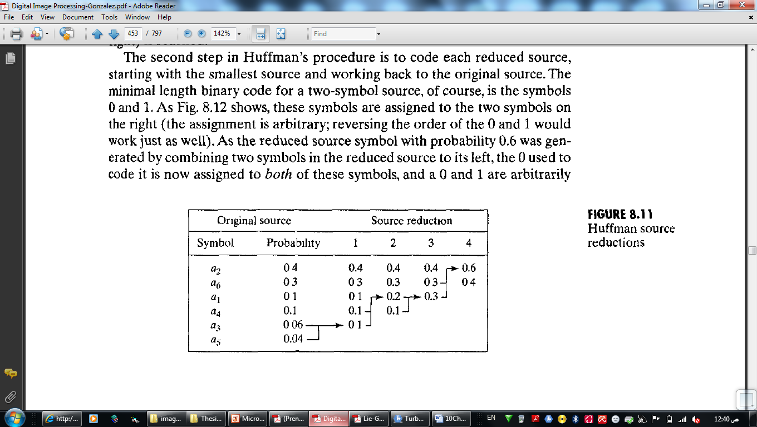
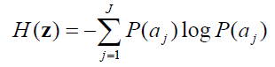
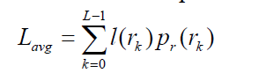
Huffman Coding
From Information theory
Average information per source output (entropy) :
The average number of bits to represent each pixel (Average of bits ):

Slide 18
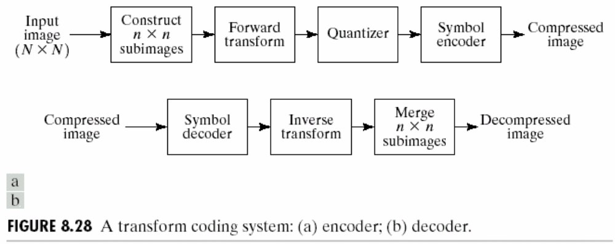
Transform Coding
The idea of transform encoding is to transform the source information from one form into another which lending itself more readily to the application of compression.

Slide 19
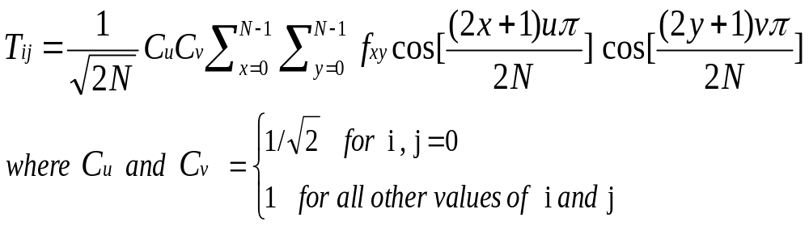
Transform Coding
The transformation of 2D matrix of the original image can be carried out using a mathematical technique known as discrete cosine transform (DCT) applying after dividing images into sub-blocks.
The produced Blocks Contains DC and AC coefficients.

Slide 20
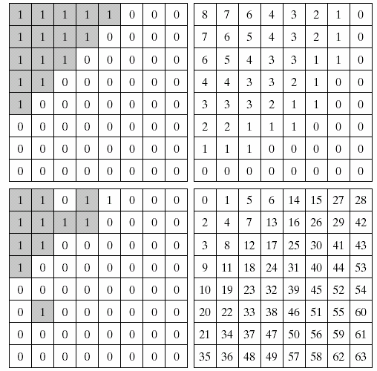
Transform Coding
Bit-allocation done using special mask such as Zonal mask.
Q : what is the type of this phase ?

Slide 21
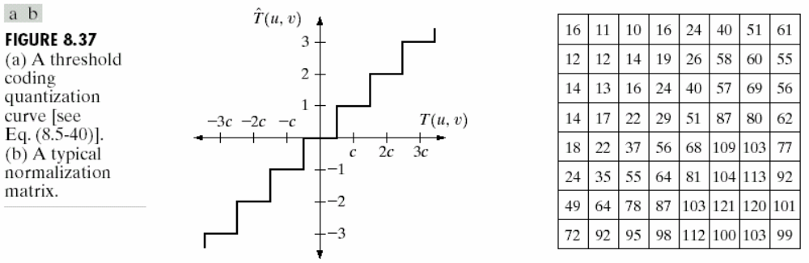
Transform Coding
Quantization using special matrix such as :

Slide 22
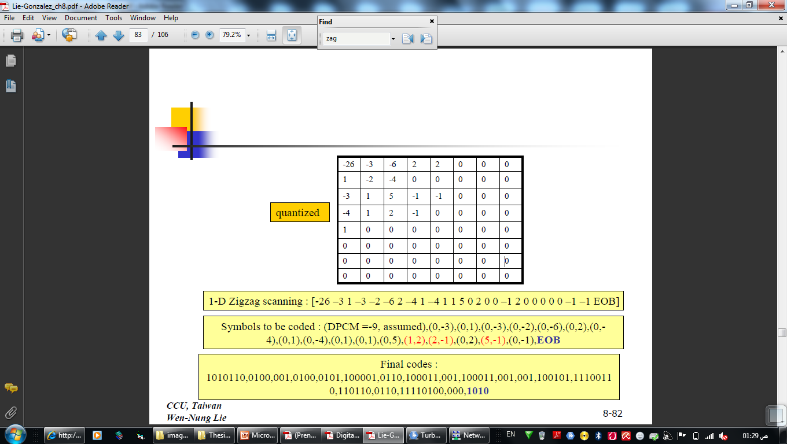
Transform Coding (JPEG)
DC and AC coding, DC using Difference encoding and AC using VLC.
Scanning AC coefficients using an appropriate principle such as zeg-zag scan.
EOB used in the end of encoded blocks.

Slide 23
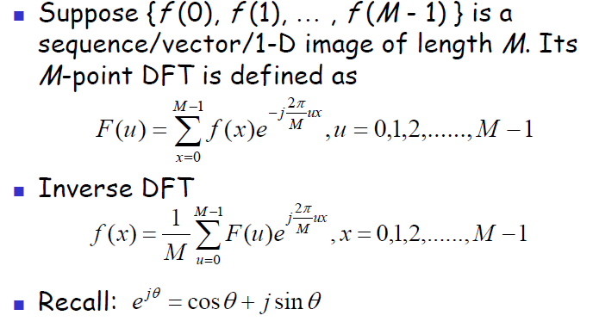
1D
Discrete Fourier Transform (DFT)

Slide 24
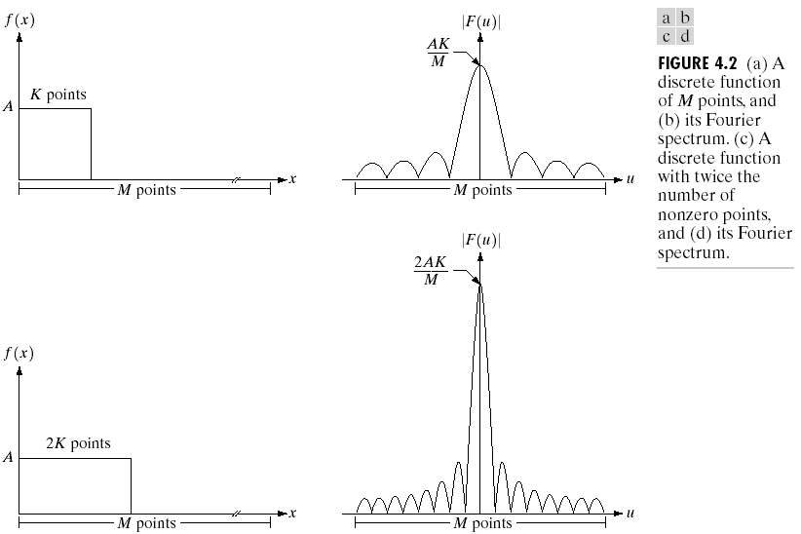
Fourier Spectrum

Slide 25
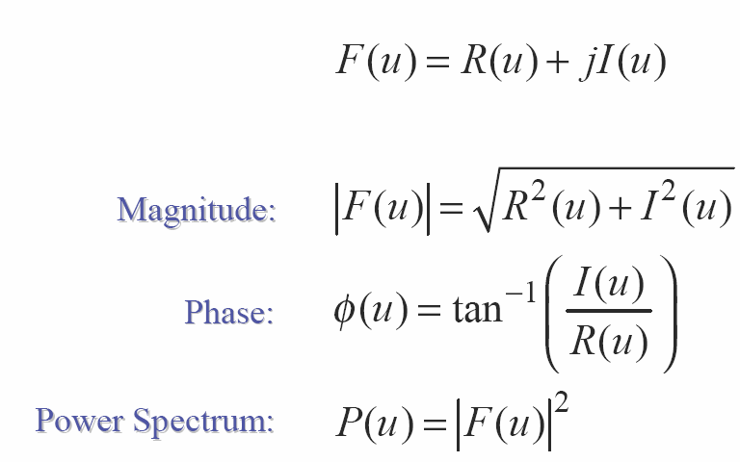
Magnitude, Phase and Power
Spectrum

Slide 26
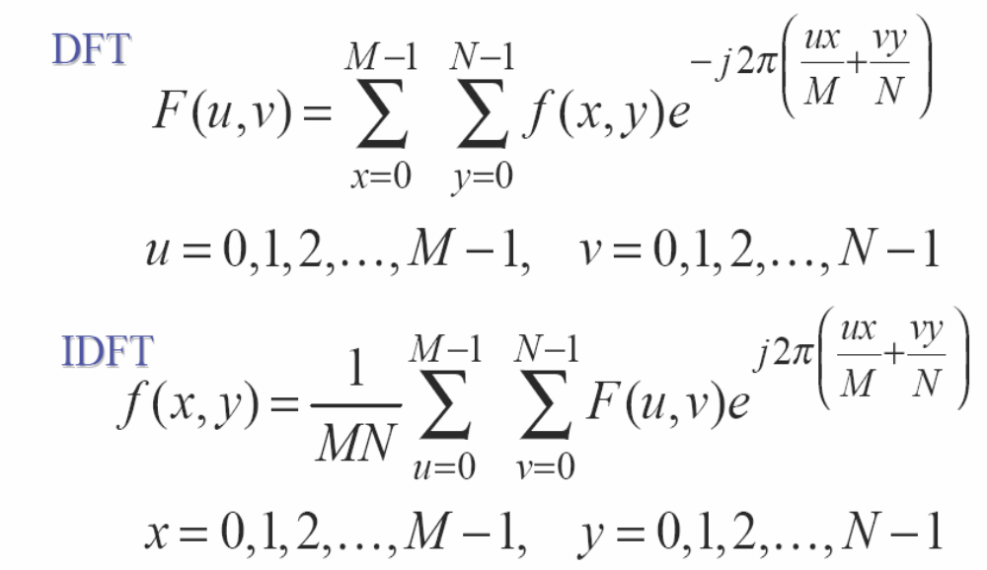
2D DFT

Slide 27
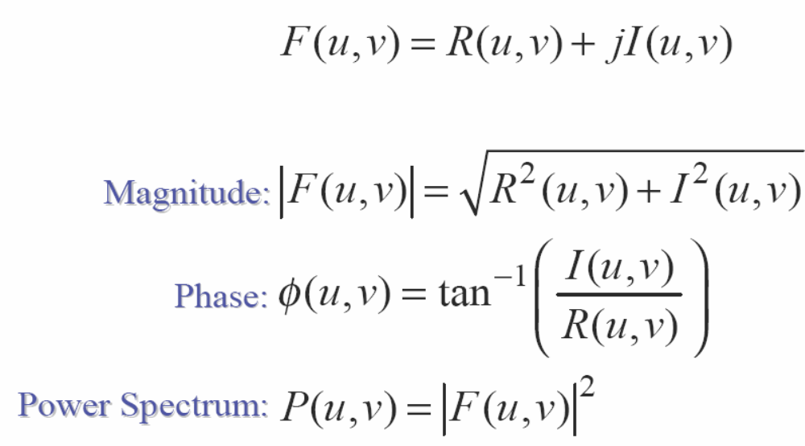
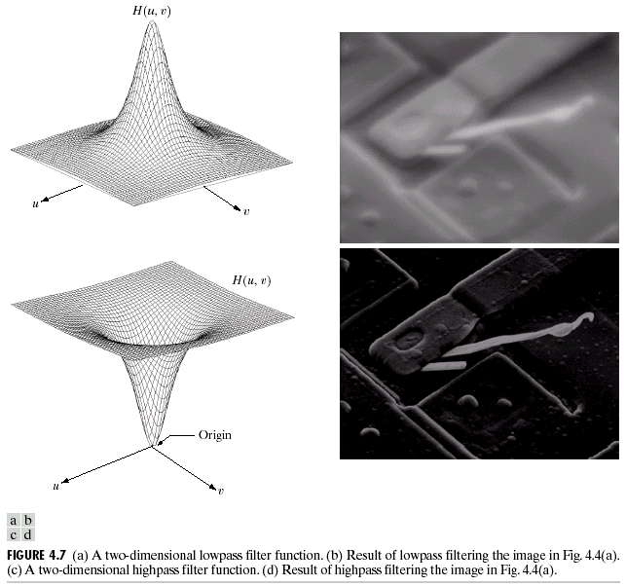
Magnitude, Phase and Power
Spectrum

